Slide 1
CLASSIFICATION OF QUEUING MODELS

Slide 2
Intro...
Queues are a part of everyday life.
We all wait in queues to make bank deposit, obtain a food in a cafeteria
The Queuing models are very helpful for determining how to operate a queuing system in the most effective way if too much service capacity to operate the system involves excessive costs.
The models enable finding an appropriate balance between the cost of service and the amount of waiting.

Slide 3
Customers waiting in a queue to be served can be selected for service according to many different principles.
We first consider the three classical queuing disciplines:

Slide 4
FCFS First Come - First Served.
It is often called a fair queue or an ordered queue, and this discipline is often preferred in real-life when customers are human beings.
It is also denoted as FIFO: First In - First Out. Note that First In -First Out refers to the queue only, not to the total system.
LCFS Last Come - First Served.
This is the stack principle. It is used e.g. in storages, on shelves of shops etc. This discipline is also denoted as LIFO: Last In - First Out.
SIRO Service In Random Order.
All customers waiting in the queue have the same probability of being chosen for service.
This is also called RANDOM or RS (Random Selection).

Slide 5
The first two disciplines only take the arrival times into considerations, while the third does not consider any criteria and so does not require any memory.
For the three above-mentioned cases the total waiting time for all customers is the same.
In queuing theory we often assume that the total offered traffic is independent of the queueing discipline.
For computer systems we often try to reduce the total waiting time.

Slide 6
It can be done by using the service time as criterion:
SJF Shortest Job First (SJN = Shortest Job Next, SPF = Shortest Processing Time First,
RR Round Robin. A customer served is given at most a fixed service time (time slice).
If the service is not completed during this interval, the customer returns to the queue which is FCFS.

Slide 7
Priority of customers
In real life customers are often divided into P priority classes, where a customer, who belongs to class V has higher priority than a customer, who belongs to class V+ 1.
We distinguish between two types of priority:
NON-PREEMPTIVE = HOL:
A new arriving customer with higher priority than a customer being served waits until a server becomes idle (and all customers with higher priority have been served).
This discipline is also called HOL, Head-of-the-Line.
PREEMPTIVE:
A customer being served having lower priority than the arriving customer is interrupted.

Slide 8
Little's theorem
This is the only general result that is valid for all queuing systems.
We consider a queuing system, where customers arrive under a stochastic process.
Customers enter the system at a random time and wait to get service, after being served they leave the system.
We consider a time space T and assume that the system is in statistic equilibrium at initial
time t = 0.

Slide 9
We have the following notations :
N(T) = number of arrivals in the period T.
A(T) = the total service times of all customers in the period T
= the carried traffic volume.
Y(T) = N(T)/T the average call intensity in the period T.
W(T) = A(T)/N(T) mean holding time in system per call in the period T.
L(T) = A(T)/T the average number of calls in the system in the period T.

Slide 10


If the limits of
This simple formula is valid for all general queuing system
Little's theorem tells that the average queue length is equal to the arrival intensity multiplied by the mean waiting time

Slide 11
Characteristics of the queuing system:
Input source
Queue discipline
Service mechanism

Slide 12
Input source
One characteristic of the input source is the size.
The size is the total number of units that
might require service from time to time.
It may be assumed to be finite or infinite.
The customer assumption is that they generate according to ‘Poisson Distribution’ at a certain average rate.
Therefore, the equivalent assumption is that they generate according to exponential distribution between consecutive arrivals.
To solve the problems use & assume customer population as ∞

Slide 13
Queue Discipline
A queue is characterized by maximum permissible number of units that it contains.
Queues are called finite or infinite, according to whether number is finite or infinite.
The service discipline refers to the order in which number of queues are selected for service.
Ex: It may be FIFO, random or priority; FIFO is usually assumed unless stated otherwise.

Slide 14
Service mechanism
This consists of one or more service facilities each of which contains one or more parallel service channel.
If there is more than one service facility, the arrival unit may receive the service from a sequence of service channels.
At a given facility, the arrival enters at the service facility and is completely served by that server.
The time elapsed from the commencement of the service to its completion for an unit at the service facility is known as service time usually, service time follows as exponential distribution.

Slide 15
kendal & Lee notations
D.G. Kendall (1951 [84]) has introduced the following notation for queueing models:
A/B/n
Where
A = arrival process
B = service time distribution
n = number of servers

Slide 16
For traffic processes we use the following standard notations:
M = Markovian. Exponential time intervals (Poisson arrival process, exponentially distributed service times).
D = Deterministic. Constant time interval.
Ek = Erlang-k distributed time interval (E1 = M).
Hn/= Hyper-exponential of order n.
G = General. Arbitrary time distribution.
GI = General Independent, renewal arrival process.

Slide 17
Example of Ordinary queuing models
M/M/n is a pure delay system with Poisson arrival process, exponentially distributed service times and n servers.
GI/G/1 is a general delay system with only one server.

Slide 18
Generally, any queuing models may be completely specified in the following symbolic form
a / b/ c : d / e
a =Type of distribution of inter – arrival time
b =Type of distribution of inter – service time
c =Number of servers
d =Capacity of the system
e =Queue discipline
M =Arrival time follows Poisson distribution and
service time follows an exponential distribution.

Slide 19
Model I : M / M / 1 : / FCFS
Where
M = Arrival time follows a Poisson distribution
M = Service time follows a exponential distribution
1 = Single service model
Capacity of the system is infinite
FCFS Queue discipline is first come first served

Slide 20
Model II : M / M / 1 : N / FCFS
Where N Capacity of the system is finite
Model III : M / M / 1 : / SIRO
Where SIRO Service in random order
Model IV : M / D / 1 : / FCFS
Where D Service time follows a constant distribution or is deterministic
Model V : M / G / 1 : / FCFS
Where G Service time follows a general distribution or arbitrary distribution
Model VI : M / Ek / 1 : / FCFS
Where Ek Service time follows Erlang distribution with K phases.
Model VII : M / M / K : / FCFS
Where K Multiple Server model
Model VIII : M / M / K : N / FCFS

Slide 21
Queue model –I
Model: (M/M/1):( ∞/FIFO)
In this model we assume that arrival follows a Poisson distribution and services follows an exponential distribution.
In this model we assume the arrival rate is λ and service rate is μ.

Slide 22

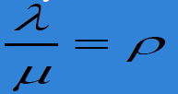
probability of system being idle
Utilization factor traffic intensity
Where λ = Mean arrival rate ; μ= mean service rate

Slide 23


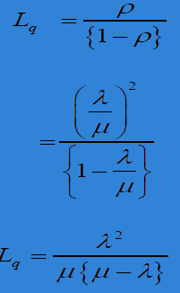
Average number (Ls) of customers in the system
Average number of customers in the Queue(Lq)

Slide 24
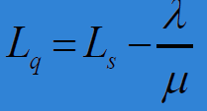
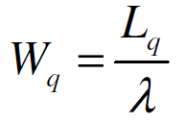
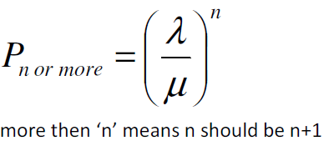
The value of Lq can also be calculated by
Expected waiting time in the queue
Probability that n or more units in the system

Slide 25
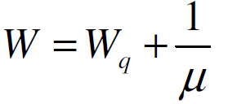
Expected waiting time in the system

Slide 26
Example
Arrivals at a telephone booth are considered to be Poisson at an average time of 8 min between our arrival and the next. The length of the phone call is distributed exponentially, with a mean of 4 min.
Determine
(a) Expected fraction of the day that the phone will be in use.
(b) Expected number of units in the queue
(c) Expected waiting time in the queue.
(d) Expected number of units in the system.
(e) Expected waiting time in the system

